Slide 1
Accounting Principles
Thirteenth Edition
Weygandt ● Kimmel ● Kieso
Chapter 4
Completing the Accounting Cycle
This slide deck contains animations. Please disable animations if they cause issues with your device.

Slide 2
Chapter Outline
Learning Objectives
L O 1 Prepare a worksheet.
L O 2 Prepare closing entries and a post-closing trial balance.
L O 3 Explain the steps in the accounting cycle and how to prepare correcting entries.
L O 4 Identify the sections of a classified balance sheet.

Slide 3
The Worksheet
LEARNING OBJECTIVE 1
Prepare a worksheet.
Multiple-column form used in preparing financial statements
Not a permanent accounting record
May be a computerized worksheet
Prepared using a five step process
Use of worksheet is optional
L O 1

Slide 4
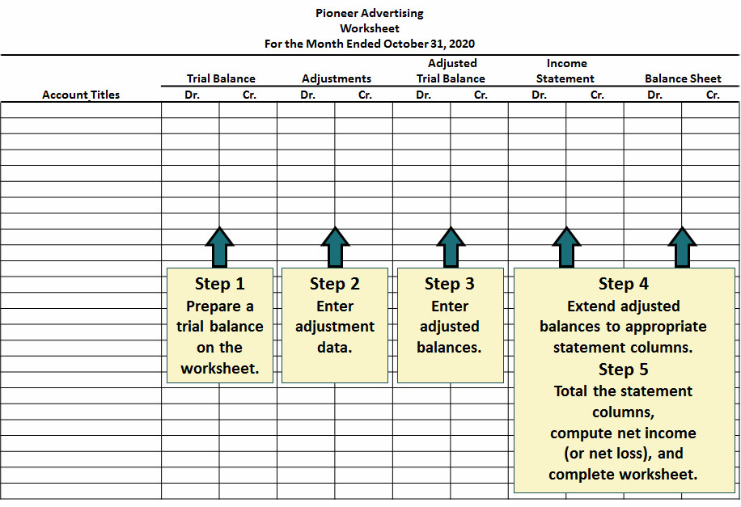
The Worksheet
L O 1

Slide 5
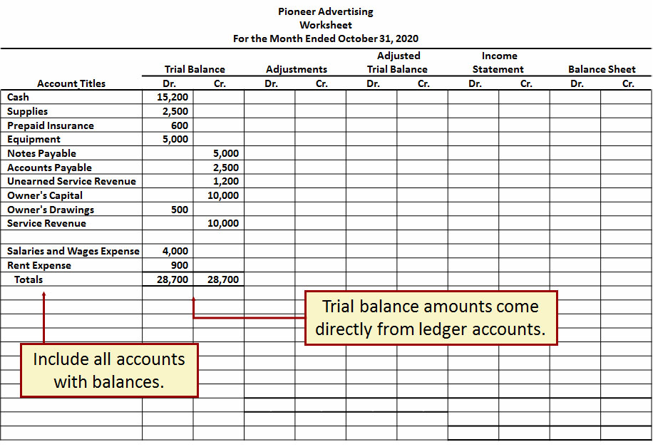
Step 1
L O 1

Slide 6
Step 2 Enter Adjustments
The adjustments are the same as in Illustration 3.23.
a. Pioneer debits an additional account, Supplies Expense, $1,500 for the cost of supplies used, and credits Supplies, $1,500.
b. Pioneer debits an additional account, Insurance Expense, $50 for the insurance that has expired, and credits Prepaid Insurance, $50.
c. The company needs two additional depreciation accounts. It debits Depreciation Expense, $40 for the month’s depreciation, and credits Accumulated Depreciation—Equipment $40.
d. Pioneer debits Unearned Service Revenue, $400 for services performed, and credits Service Revenue, $400.
e. Pioneer debits an additional account, Accounts Receivable, $200 for services performed but not billed, and credits Service Revenue, $200.
f. The company needs two additional accounts relating to interest. It debits Interest Expense, $50 for accrued interest, and credits Interest Payable, $50.
g. Pioneer debits Salaries and Wages Expense, $1,200 for accrued salaries, and credits an additional account, Salaries and Wages Payable, $1,200.
L O 1

Slide 7
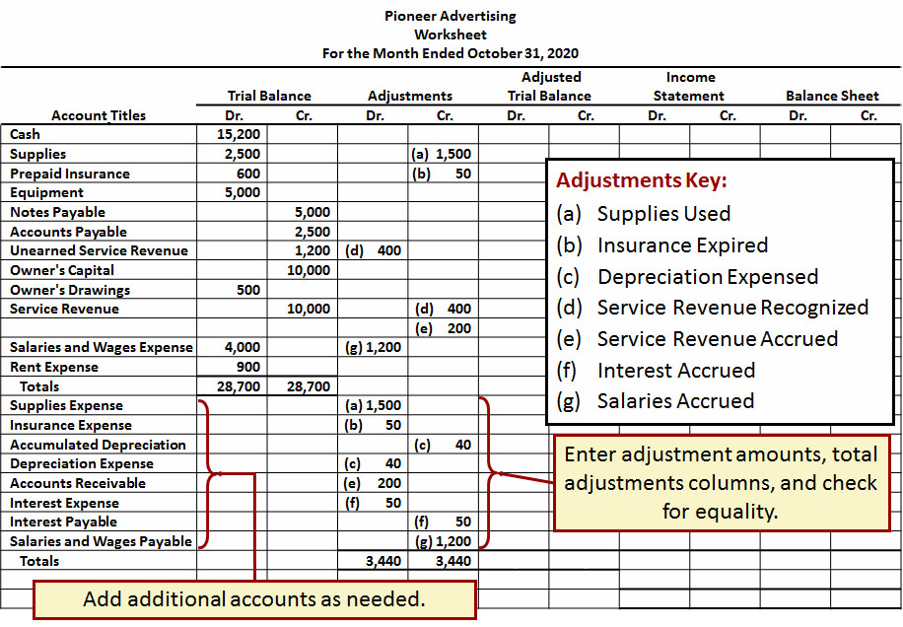
Step 2
L O 1

Slide 8
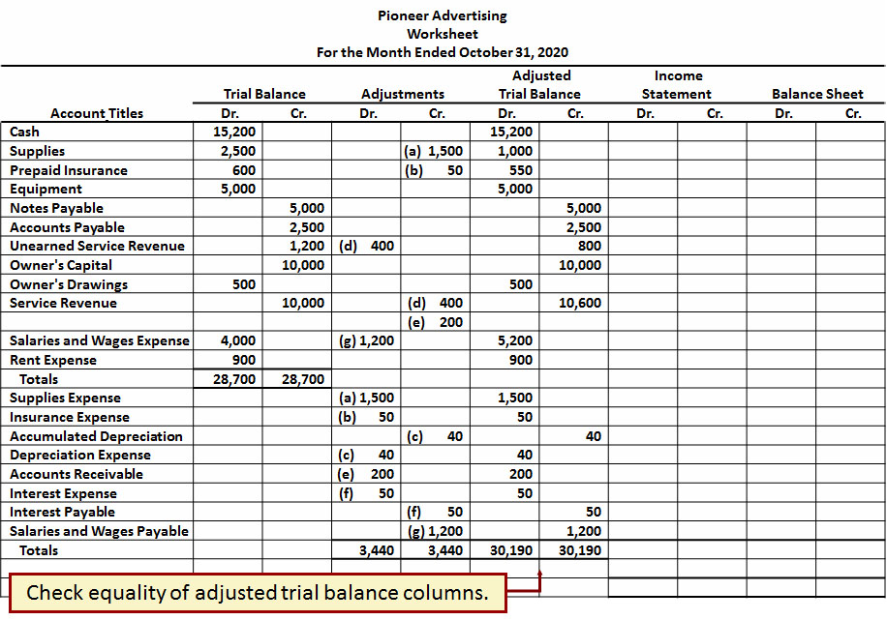
Step 3
L O 1

Slide 9
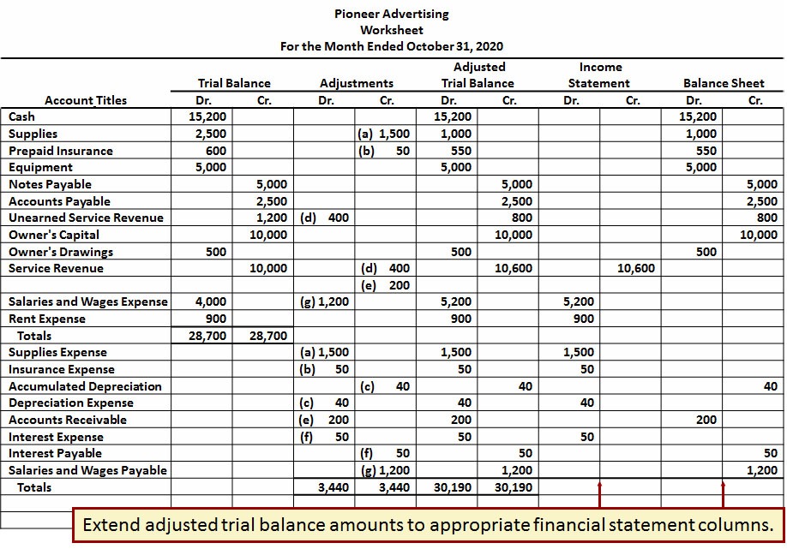
Step 4
L O 1

Slide 10
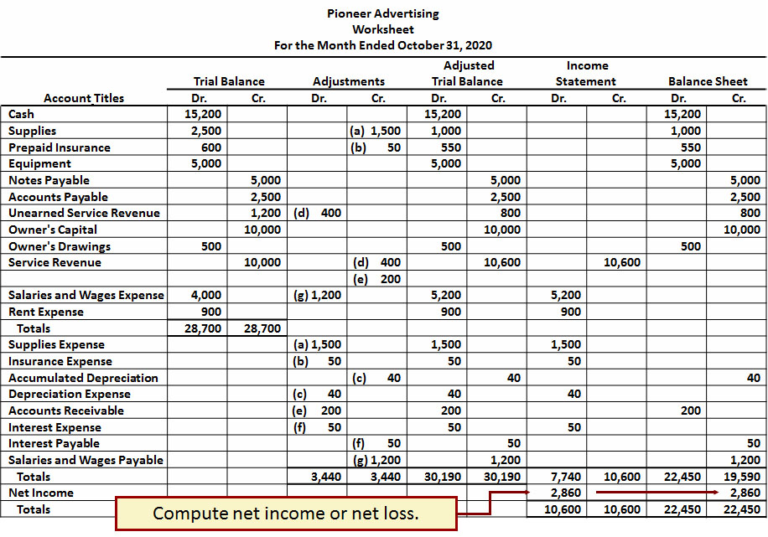
Step 5
L O 1

Slide 11
Steps in Preparing a Worksheet (1 of 2)
Net income is shown on a worksheet in the:
a. income statement debit column only.
b. balance sheet debit column only.
c. income statement credit column and balance sheet debit column.
d. income statement debit column and balance sheet credit column.
L O 1

Slide 12
Steps in Preparing a Worksheet (2 of 2)
Net income is shown on a worksheet in the:
a. income statement debit column only.
b. balance sheet debit column only.
c. income statement credit column and balance sheet debit column.
d. Answer: income statement debit column and balance sheet credit column.
L O 1

Slide 13
Preparing Financial Statements from a Worksheet
Income statement is prepared from the income statement columns.
Balance sheet and owner’s equity statement are prepared from the balance sheet columns.
Companies can prepare financial statements before they journalize and post adjusting entries.
L O 1

Slide 14
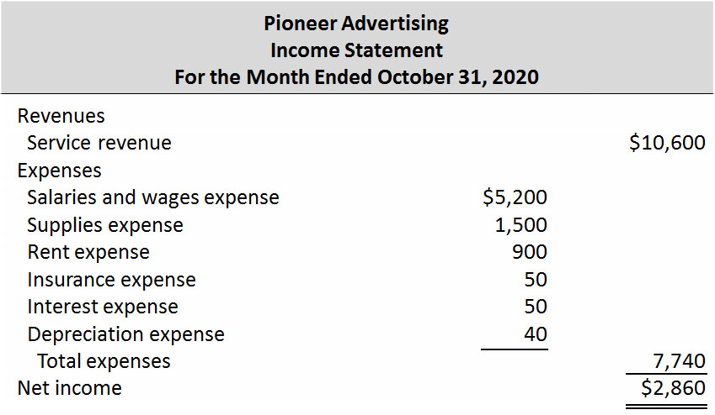
Preparing Statements from a Worksheet (1 of 3)
L O 1

Slide 15
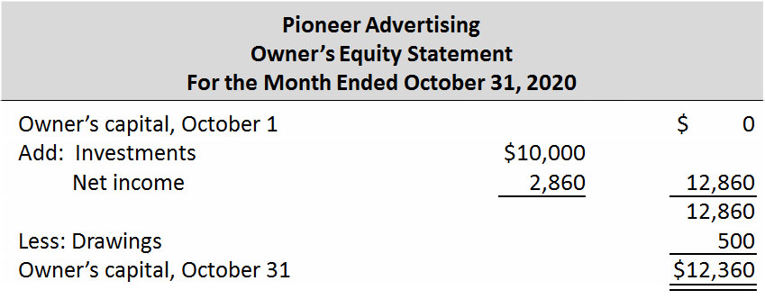
Preparing Statements from a Worksheet (2 of 3)
L O 1

Slide 16
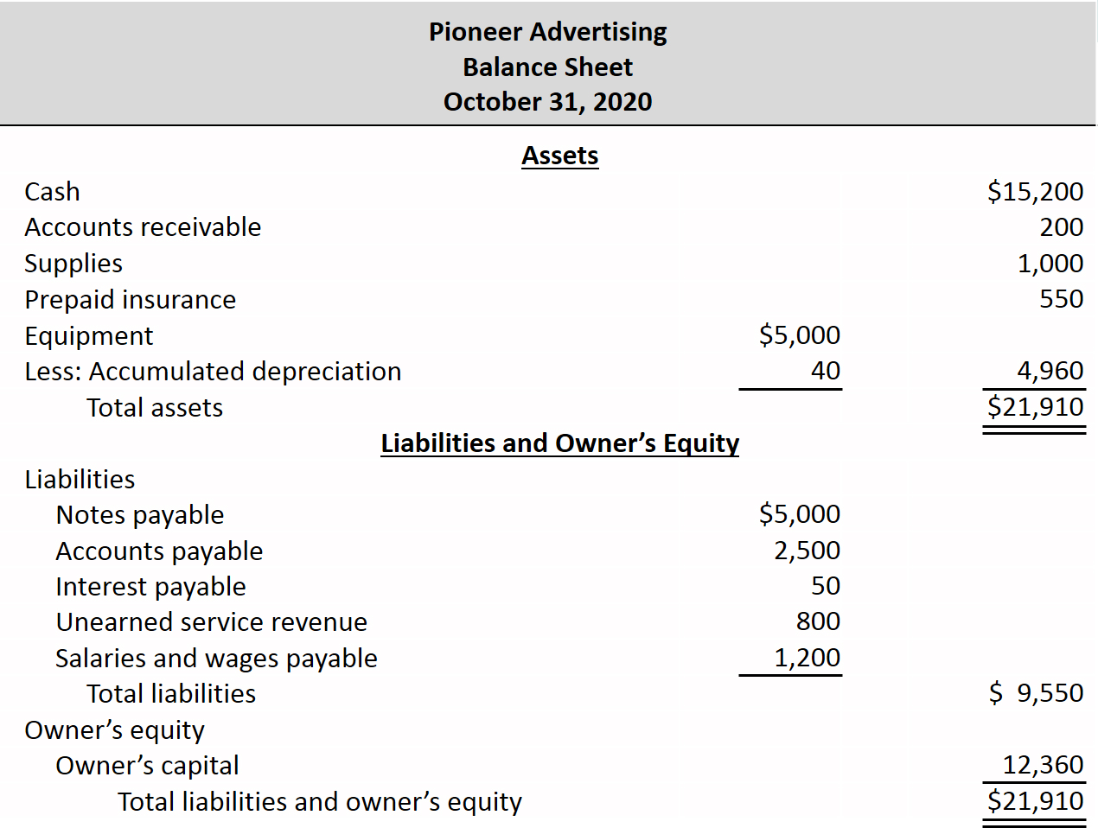
Preparing Statements from a Worksheet (3 of 3)
L O 1

Slide 17
Preparing Adjusting Entries from a Worksheet
Adjusting entries are prepared from the adjustments columns of the worksheet.
Journalizing and posting of adjusting entries follows the preparation of financial statements when a worksheet is used.
L O 1

Slide 18
Do It! 1: Worksheet
Susan Elbe is preparing a worksheet. Explain to Susan how she should extend the following adjusted trial balance accounts to the financial statement columns of the worksheet.
Cash
Balance sheet (debit)
Owner’s Drawings
Balance sheet (debit)
Accumulated Depreciation
Balance sheet (credit)
Service Revenue
Income statement (credit)
Accounts Payable
Balance sheet (credit)
Salaries and Wages Expense
Income statement (debit)
L O 1

Slide 19
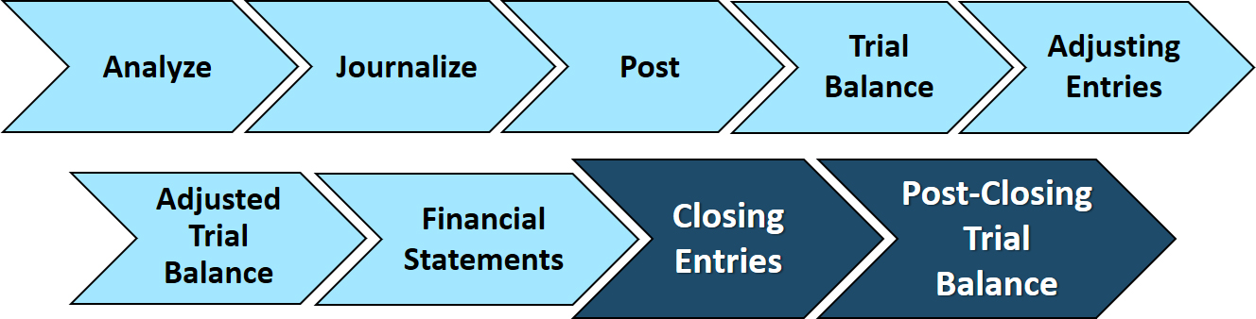
Closing the Books
LEARNING OBJECTIVE 2
Prepare closing entries and a post-closing trial balance.
At the end of the accounting period, the company makes the accounts ready for the next period.
L O 2

Slide 20
Closing the Books
Temporary
These accounts are closed
All revenue accounts
All expense accounts
Owner's drawing account
Permanent
These accounts are not closed
All asset accounts
All liability accounts
Owner's capital account
L O 2

Slide 21
Preparing Closing Entries (1 of 2)
Closing entries formally recognize in the ledger the transfer of:
Net income (or net loss) to owner’s capital.
Owner’s drawings to owner’s capital.
Produce a zero balance in each temporary account.
Companies generally journalize and post closing entries only at end of the annual accounting period.
L O 2

Slide 22
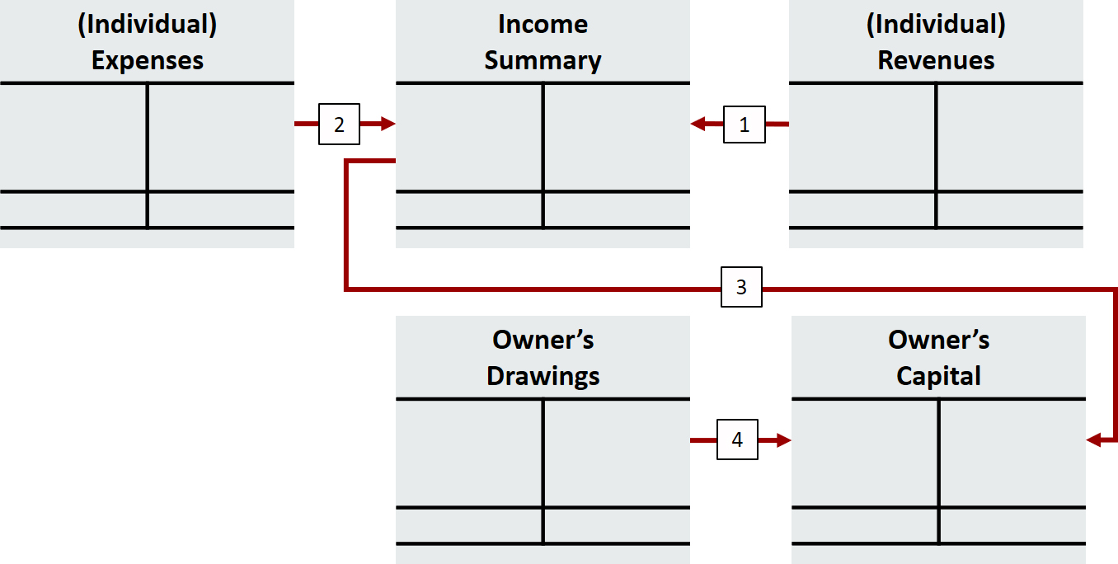
Preparing Closing Entries (2 of 2)
Key:
Close Revenues to Income Summary.
Close Expenses to Income Summary.
Close Income Summary to Owner’s Capital.
Close Owner’s Drawings to Owner’s Capital.
L O 2

Slide 23
Closing Entries Illustrated (1 of 2)
blank | General Journal | blank | blank | Page J3
Date | Account Titles and Explanations | Ref. | Debit | Credit
2020 Oct. 31 | Service Revenue | 400 | 10,600 | blank
Blank | Income Summary | 350 |  | 10,600
Blank | (To close revenue account) | blank | blank | blank
31 | Income Summary | 350 | 7,740 | blank
blank | Supplies Expense | 631 | blank | 1,500
blank | Depreciation Expense | 711 | blank | 40
blank | Insurance Expense | 722 | blank | 50
blank | Salaries and Wages Expense | 726 | blank | 5,200
blank | Rent Expense | 729 | blank | 900
blank | Interest Expense | 729 | blank | 50
blank | (To close expense accounts) | blank | blank | blank
L O 2

Slide 24
Closing Entries Illustrated (2 of 2)
blank | General Journal | blank | blank | Page J3
Date | Account Titles and Explanations | Ref. | Debit | Credit
2020 Oct. 31 | Income Summary | 350 | 2,860 | blank
blank | Owner’s Capital | 301 |  | 2,860
blank | (To close net income to capital) | Blank | blank | blank
31 | Owner’s Capital | 301 | 500 | blank
blank | Owner’s Drawings | 306 | blank | 500
blank | (To close drawings to capital) | blank | blank | blank
L O 2

Slide 25
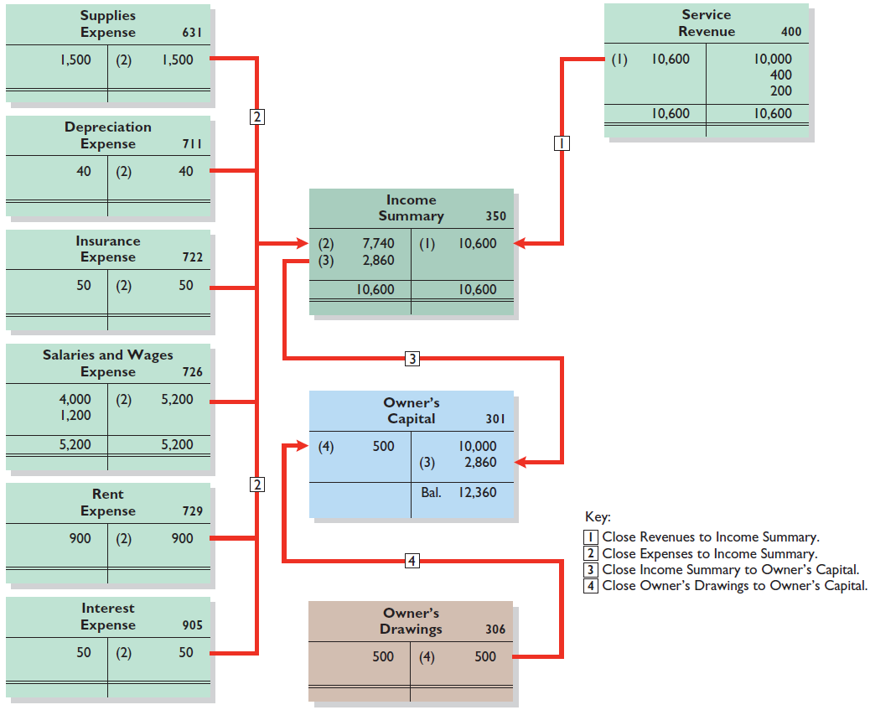
Posting Closing Entries (1 of 2)
L O 2

Slide 26
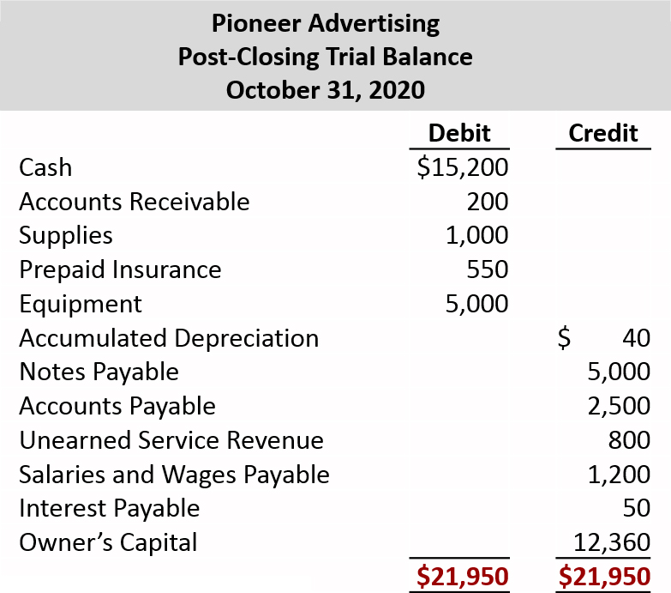
Posting Closing Entries (2 of 2)
L O 2

Slide 27
Do It! 2: Closing Entries (1 of 3)
Hancock Company has the following balances in selected accounts of its adjusted trial balance.
Accounts Payable | $27,000 | Owner’s Drawings | $15,000
Service Revenue | 98,000 | Owner’s Capital | 42,000
Rent Expense | 22,000 | Accounts Receivable | 38,000
Salaries and Wages | Blank | Supplies Expense | 7,000
Expense | 51,000 | blank | blank
Prepare the closing entries at December 31.
Service Revenue
98,000
Income Summary
98,000
L O 2

Slide 28
Do It! 2: Closing Entries (2 of 3)
Accounts Payable | $27,000 | Owner’s Drawings | $15,000
Service Revenue | 98,000 | Owner’s Capital | 42,000
Rent Expense | 22,000 | Accounts Receivable | 38,000
Salaries and Wages | Blank | Supplies Expense | 7,000
Expense | 51,000 | blank | blank
Prepare the closing entries at December 31.
Income Summary
80,000
Salaries and Wages Expense
51,000
Rent Expense
22,000
Supplies Expense
7,000
L O 2

Slide 29
Do It! 2: Closing Entries (3 of 3)
Accounts Payable | $27,000 | Owner’s Drawings | $15,000
Service Revenue | 98,000 | Owner’s Capital | 42,000
Rent Expense | 22,000 | Accounts Receivable | 38,000
Salaries and Wages | Blank | Supplies Expense | 7,000
Expense | 51,000 | blank | blank
Prepare the closing entries at December 31.
Income Summary
18,000
Owner’s Capital
18,000
Owner’s Capital
15,000
Owner’s Drawings
15,000
L O 2

Slide 30
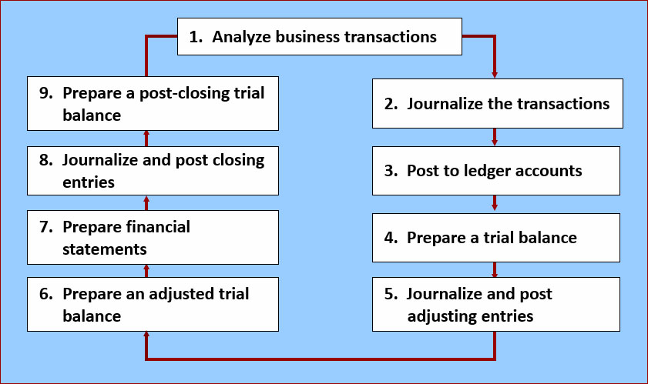
The Accounting Cycle
LEARNING OBJECTIVE 3
Explain the steps in the accounting cycle and how to prepare correcting entries.
L O 3

